Slide 1
Middleware for Distributed Applications
Microproject
KAZMI, Syed M. Mohsin, MACHADO, Rebeca
Télécom SudParis

Slide 2
Outline
Architecture and design patterns
  1.1 User Directory architecture
  1.2 MailBox Manager architecture
Decisions
Difficulties
Conclusions and demo

Slide 3
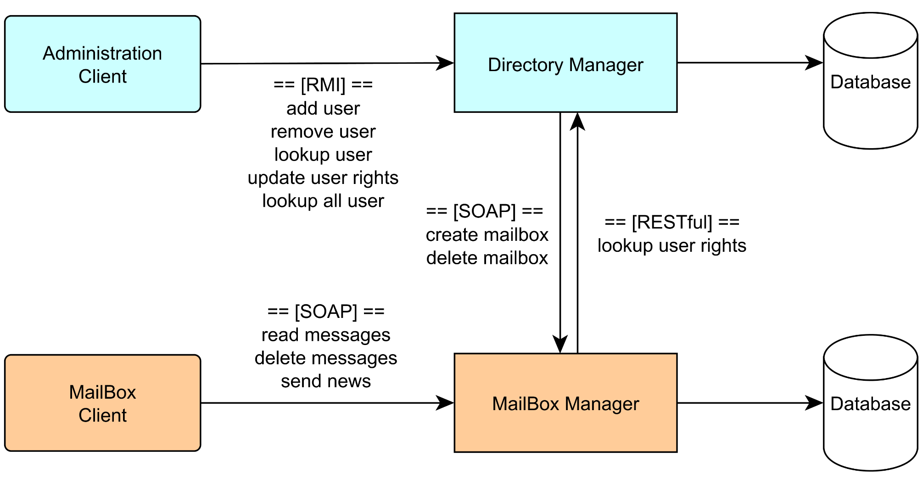
1. Architecture and design patterns

Slide 4
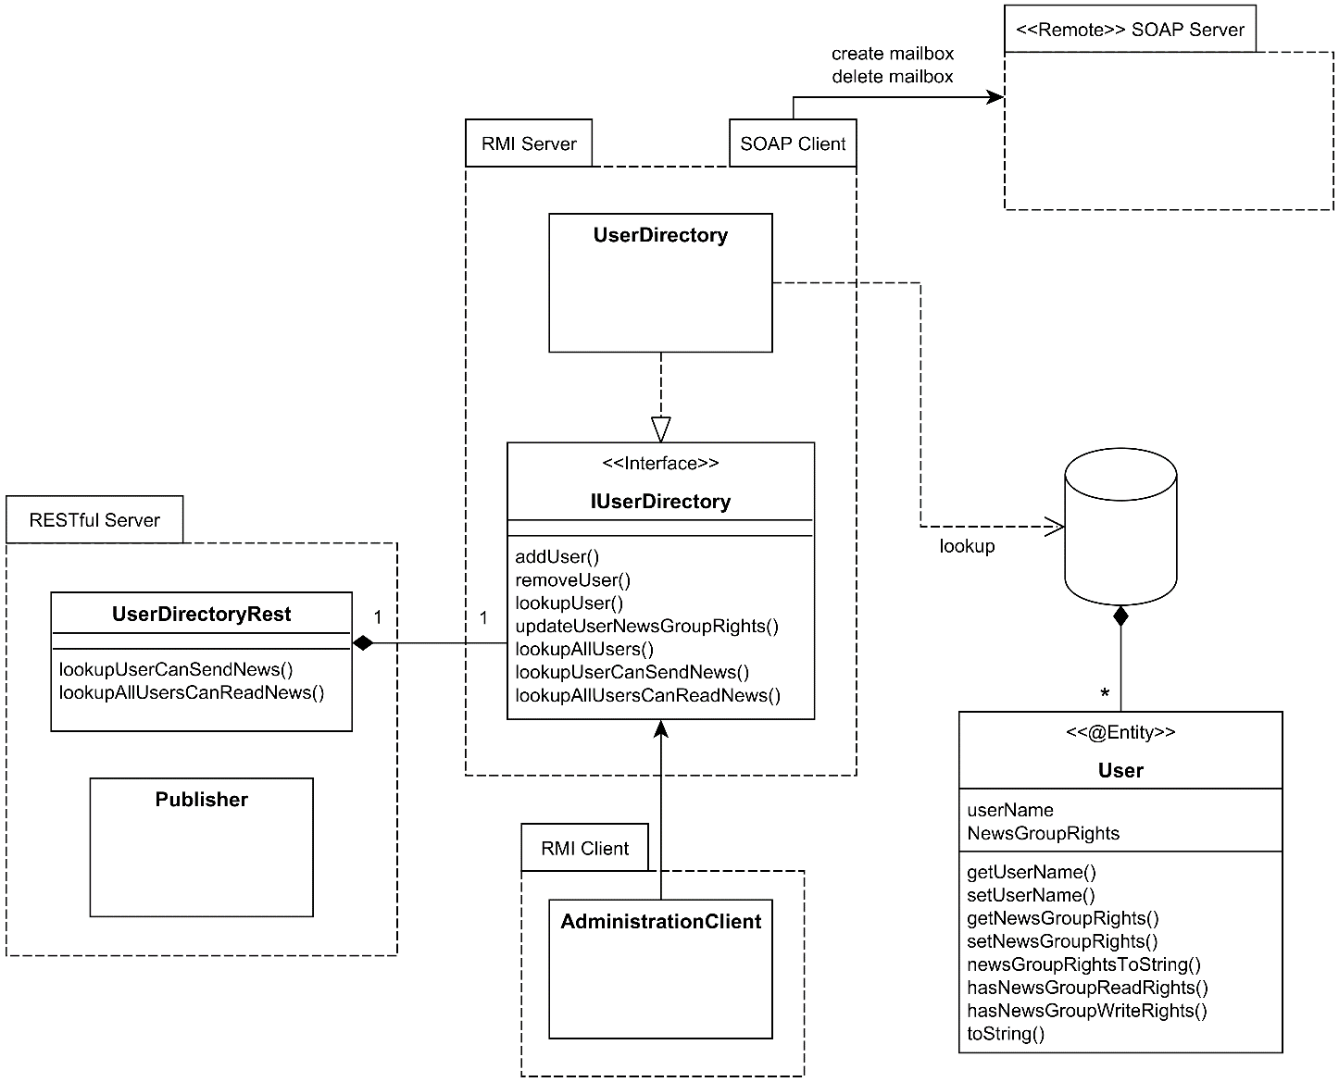
1.1 User Directory architecture

Slide 5
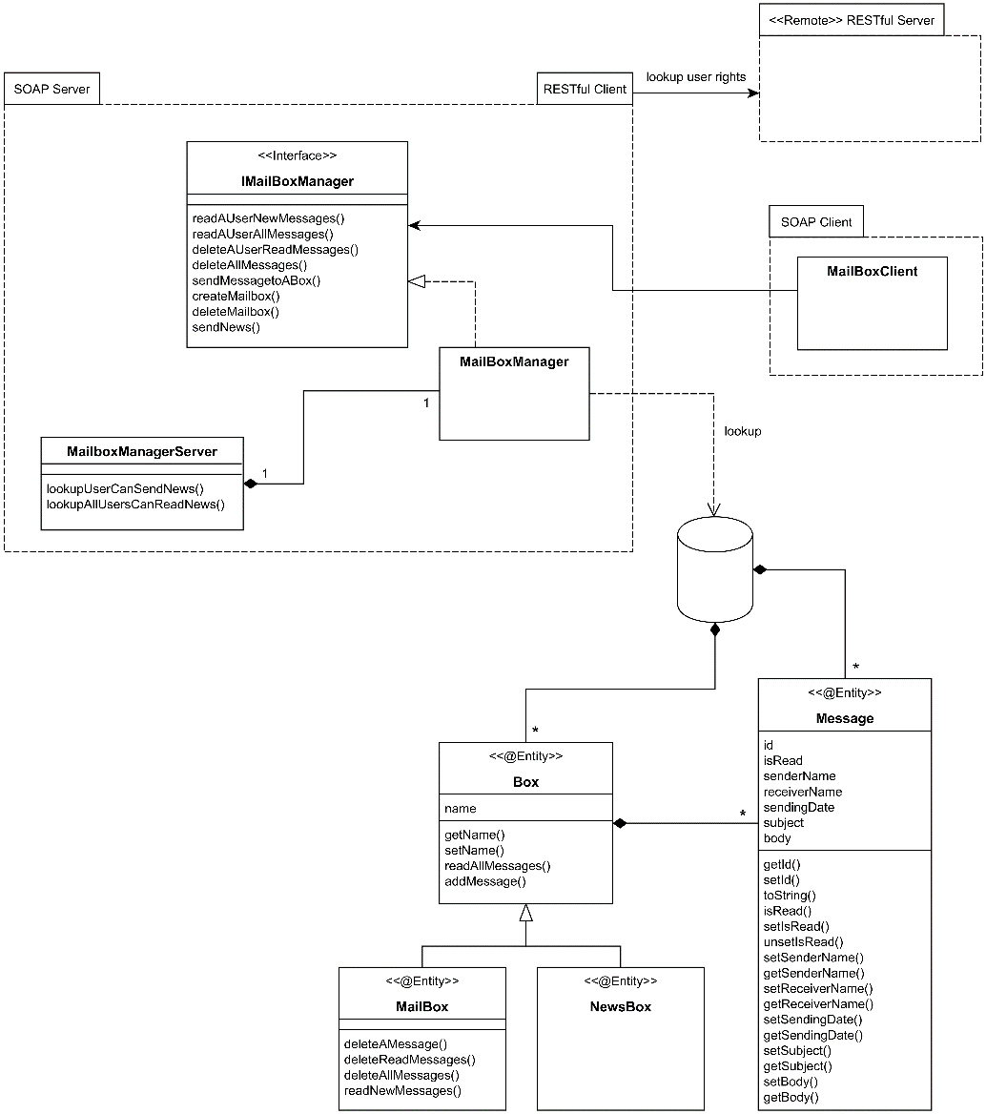
1.2 MailBox Manager architecture

Slide 6
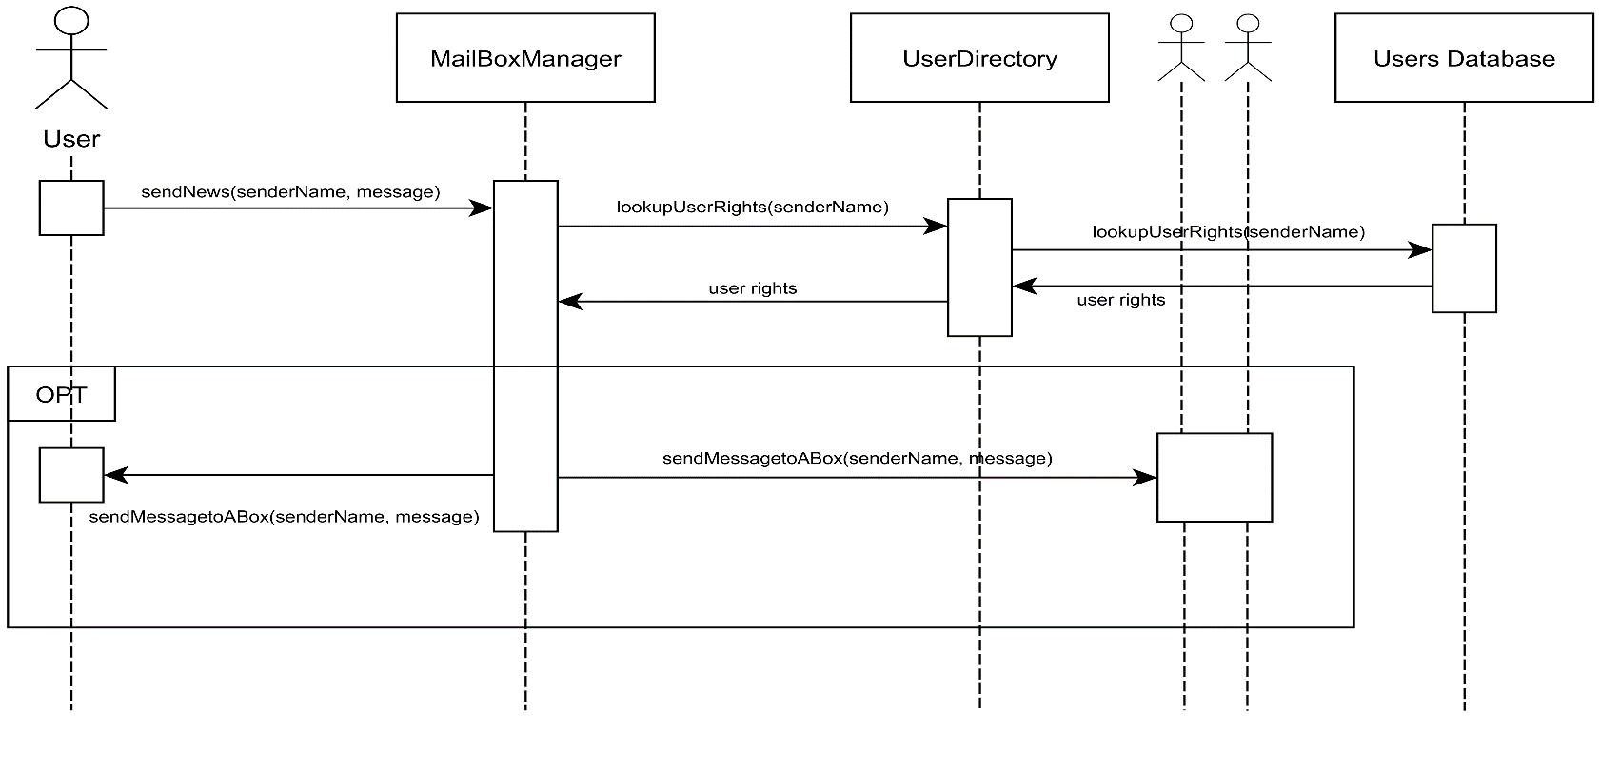
2. Decisions
Implementing three kinds of middleware
Why SOAP in the MailBox Manager?
Why REST for the Directory Manager?
News Group Box implementation

Slide 7
3. Difficulties
SOAP and databases
Integrating all middlewares (dependencies and jars)
Concurrent modification of the database
Organization constraints

Slide 8

4. Conclusions and demo
Middleware for distributed applications: pros and cons (RMI compilation)
Design patterns
Integration and dependencies
Rebeca Machado G.
rebeca.machado_garroz@telecom-sudparis.eu
Syed Muhammad Mohsin Kazmi
syed.kazmi@telecom-sudparis.eu

